Slide 1

MODULE 3: PROGRAMMING FOR BIOLOGICAL DATA
Introduction to Bioconductor
Session 9: Sequence Handling with Biostrings
Instructor: Dr. Haogao Gu | Date: February 2, 2026

Slide 2

Welcome to Phase III: Bioinformatics
Session | Topic
9 | Bioconductor & Biostrings
10 | Sanger Sequencing Analysis
11 | Phylogenetics (MSA, Trees)
12 | Visualization & Reporting
From Statistics to Sequences
We have covered R basics and statistical testing. Now we move to handling biological data directly.
Sessions 9-12 Focus:
Sequence analysis, phylogenetics, and visualization.

Slide 3








Learning Objectives
Ecosystem
Install
Biostrings
FASTA
Understand the Bioconductor repository vs CRAN.
Install packages correctly using BiocManager.
Manipulate DNA, RNA, and Amino Acid sequences.
Read, write, and process FASTA files.

Slide 4

Part 1: Bioconductor vs. CRAN
The Bioinformatics Repository

Slide 5


What is Bioconductor?
The Premier Repository
Founded in 2001 by Robert Gentleman (co-creator of R).
It is distinct from CRAN (Comprehensive R Archive Network).
"Bioconductor provides tools for the analysis and comprehension of high-throughput genomic data."

Slide 6
CRAN vs Bioconductor
Feature | CRAN | Bioconductor
Focus | General Purpose Statistics | Genomics & Bioinformatics
Packages | ~20,000+ | ~2,200 specialized
Release Cycle | Rolling (Daily) | Biannual (Spring/Fall)
Installation | install.packages() | BiocManager::install()
Objects | data.frame, matrix | DNAString, GRanges, ExpressionSet

Slide 7
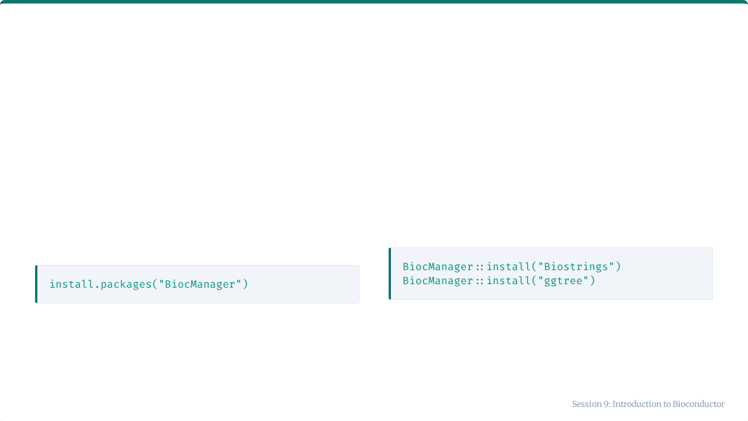
Installing with BiocManager
Step 1: Install Manager
Step 2: Install Packages
First, you need the tool that manages Bioconductor packages. This comes from CRAN.
Use the manager to install specific tools.

Slide 8
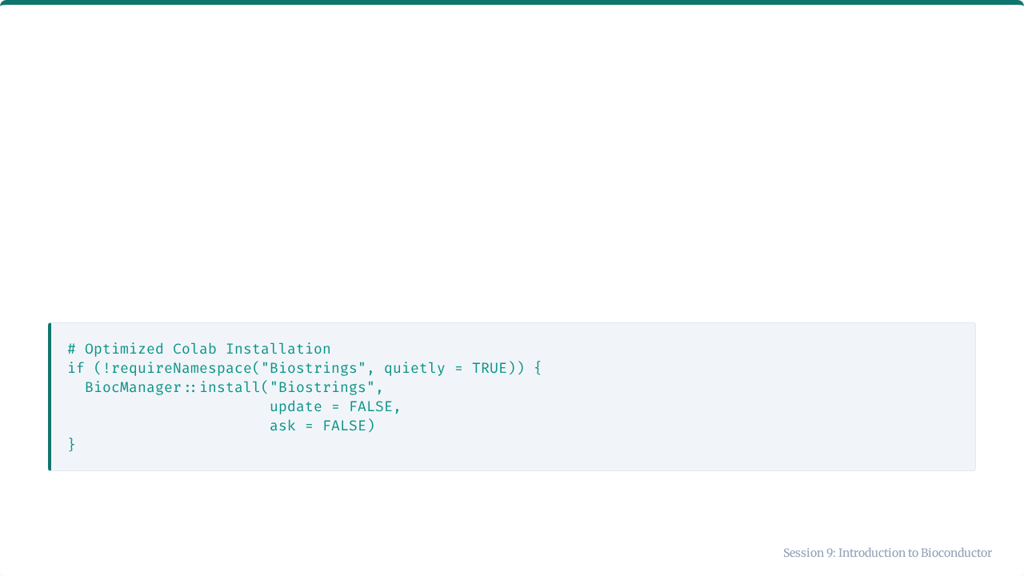

Installation in Google Colab
Performance Warning
Bioconductor installation compiles code, which can be slow in Colab. Always verify if the package is already installed to save time.
update = FALSE prevents R from trying to update all your other packages, which can take 20+ minutes.

Slide 9




Key Bioconductor Packages for MLTs
🧬
📊
🌳
📍
Biostrings
sangeranalyseR
ggtree
GenomicRanges
Core package for DNA, RNA, and Amino Acid sequence manipulation.
Quality control and processing of Sanger sequencing chromatograms (.ab1).
Visualization of phylogenetic trees and associated data.
Handling genomic coordinates (chromosomes, start/end positions).

Slide 10

Biostrings Overview
The Foundation
Biostrings is the "Excel" of sequence data in R.
•
Efficient storage (doesn't waste memory).
•
Specialized algorithms (Pattern matching).
•
File I/O (FASTA, FASTQ).

Slide 11

Part 2: Working with Biostrings
Classes, Functions, and Operations

Slide 12
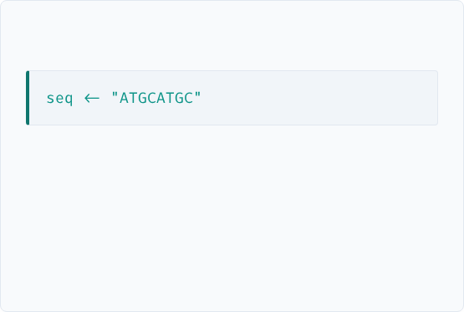
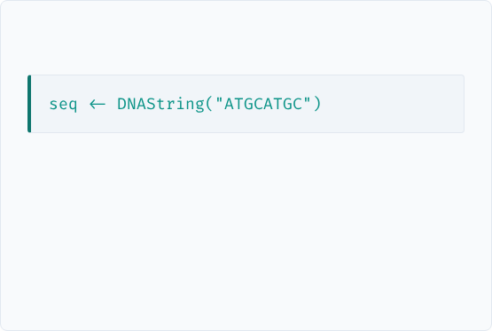
Why Not Regular R Strings?
Standard R (Character)
Biostrings (DNAString)
•
No validation (can hold "Hello World").
•
Validation: Only allows A, T, G, C, N, etc.
•
Memory intensive (stores each letter as a full character).
•
Memory: Bit-encoded (2 bits per base).
•
Context: Knows how to complement and translate.
•
No biological context.

Slide 13
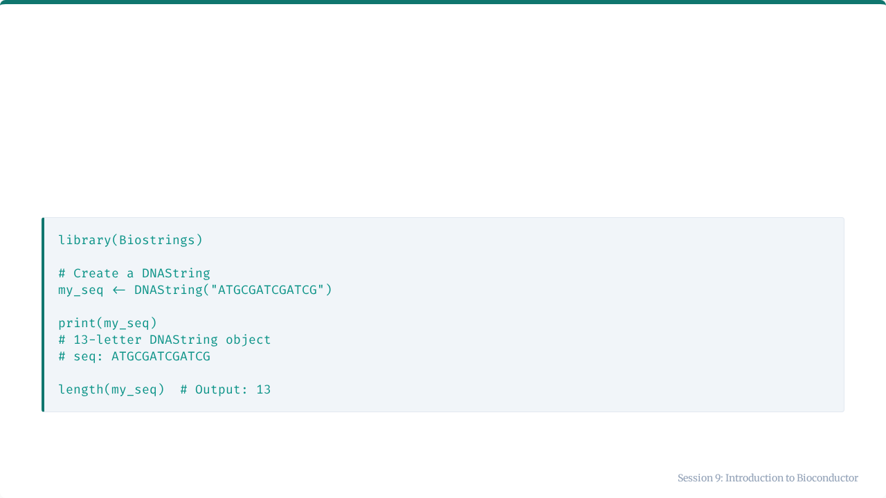
The DNAString Class
Used for holding a single sequence.

Slide 14
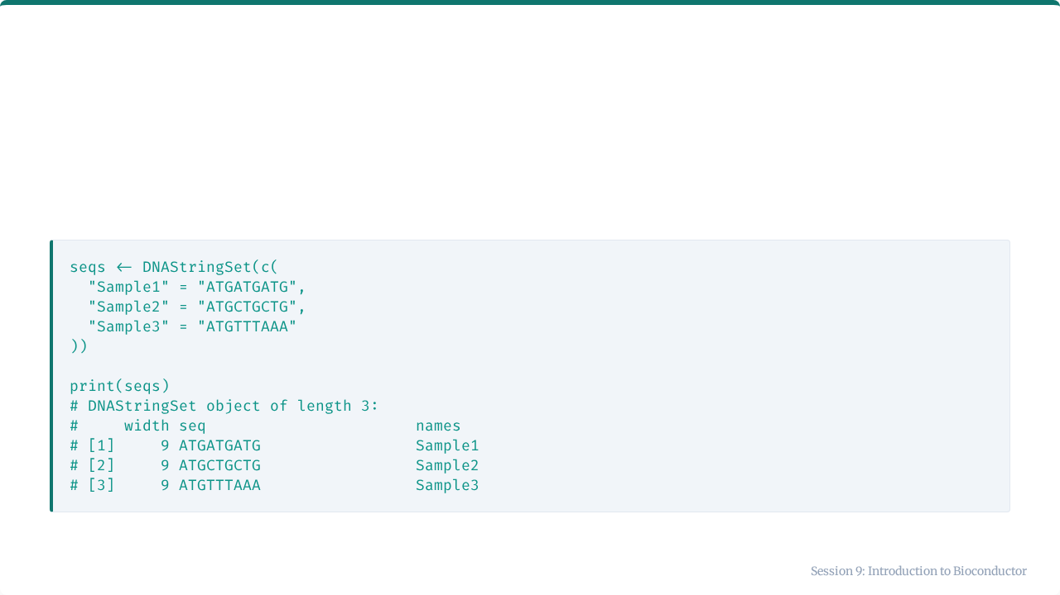
The DNAStringSet Class
Used for holding multiple sequences (e.g., from a FASTA file).

Slide 15
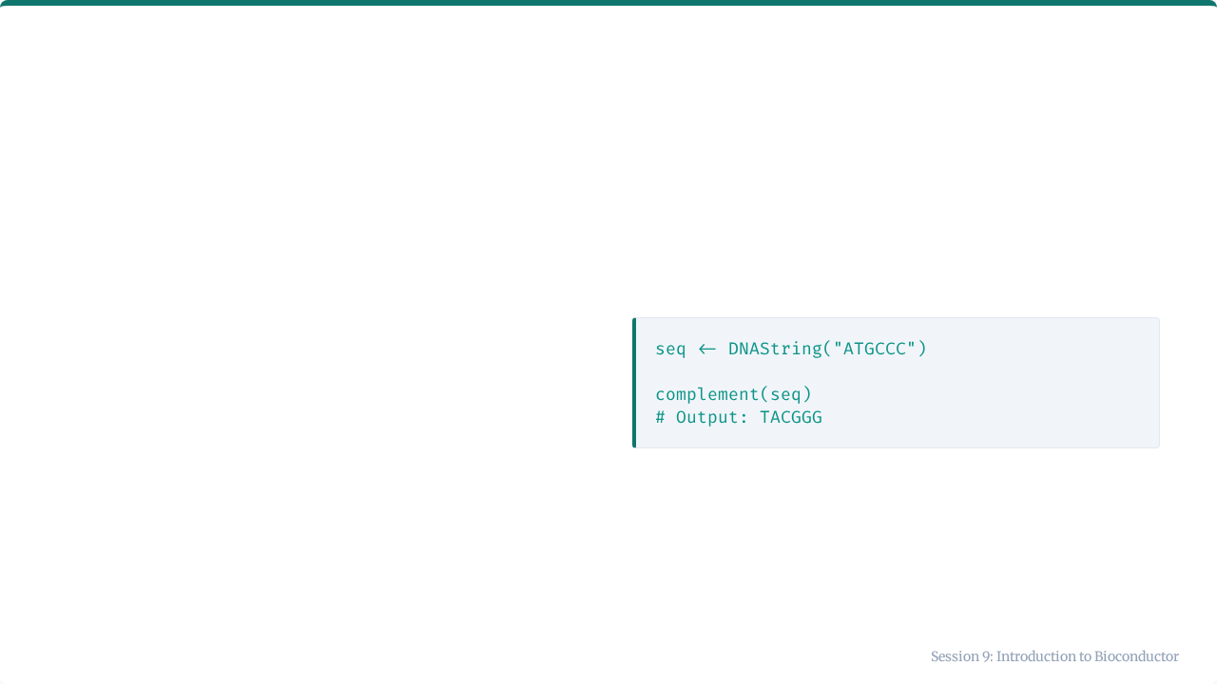
Complement Function
R Code
Biological Rule
Watson-Crick base pairing:
•
A pairs with T
•
G pairs with C
Note: This is the complement strand reading 3' to 5', or simply the paired bases.

Slide 16
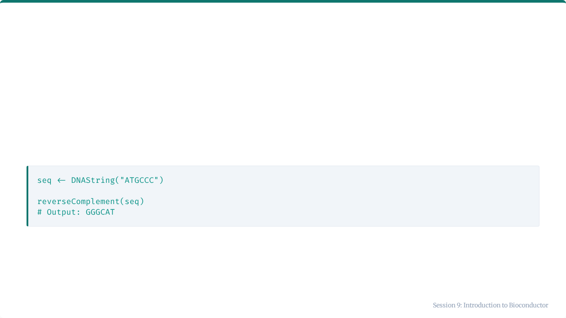
Reverse Complement
The sequence of the opposite strand, read 5' to 3'.
5' ATGCCC 3'
5' GGGCAT 3'
Clinical Note: Crucial when analyzing sequencing reads from the reverse strand.

Slide 17
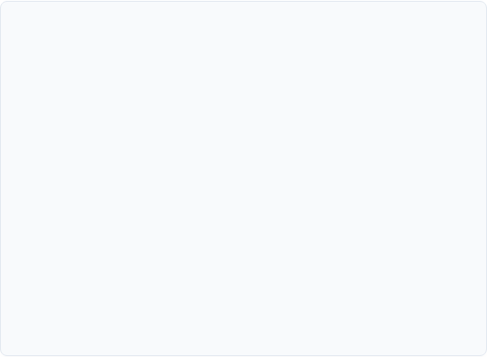
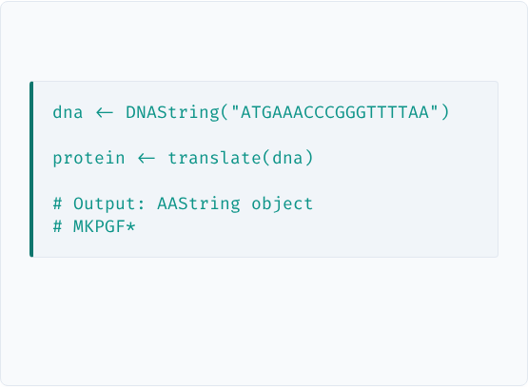
Translating DNA to Protein
The Function
R Code
The translate() function applies the Standard Genetic Code to convert triplets of nucleotides into amino acids.
M = Methionine (Start) * = Stop Codon

Slide 18
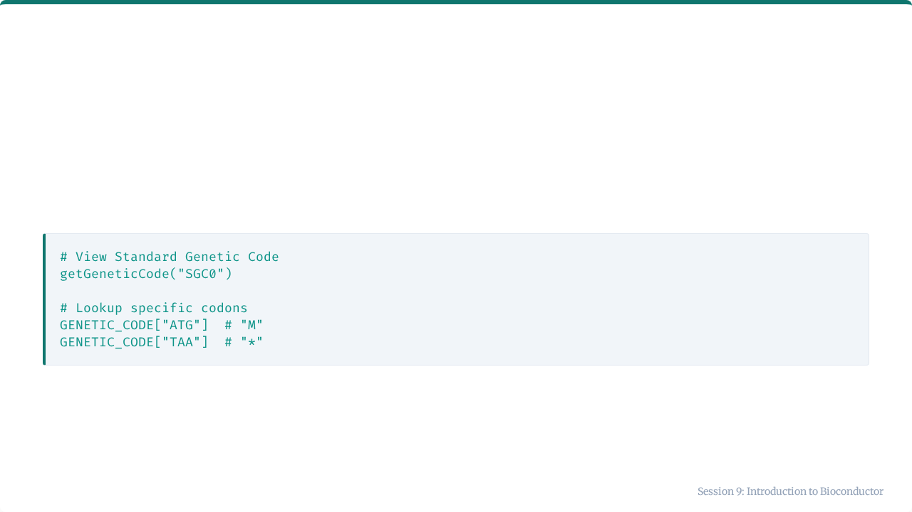
The Genetic Code
Biostrings has built-in lookup tables for the genetic code.
There are 64 possible codons coding for 20 amino acids plus stop signals.

Slide 19
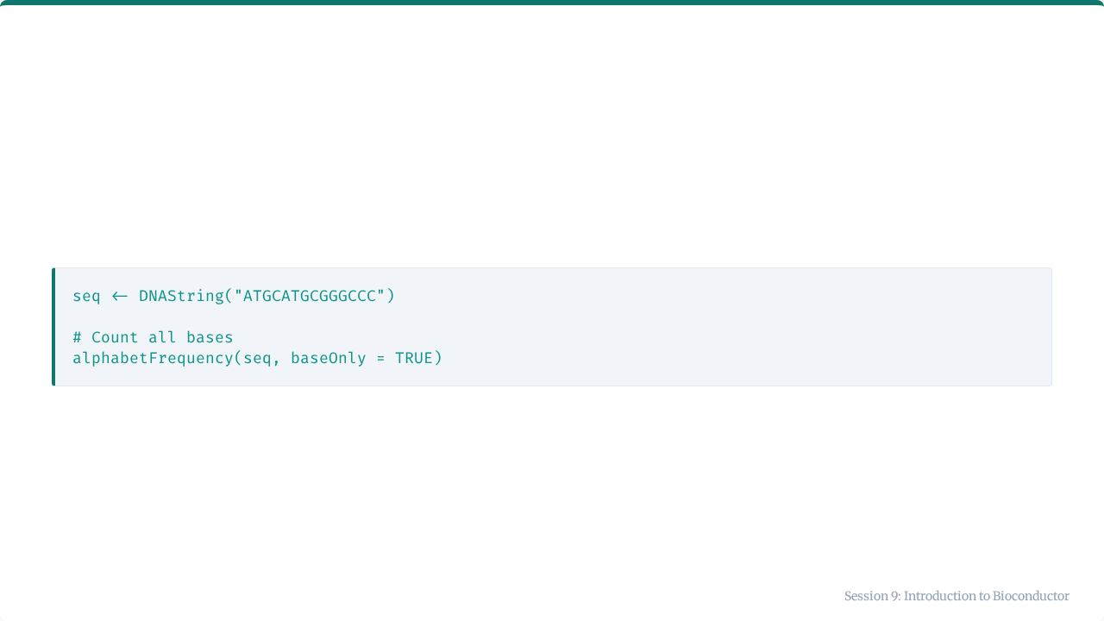

Counting Nucleotides

Slide 20
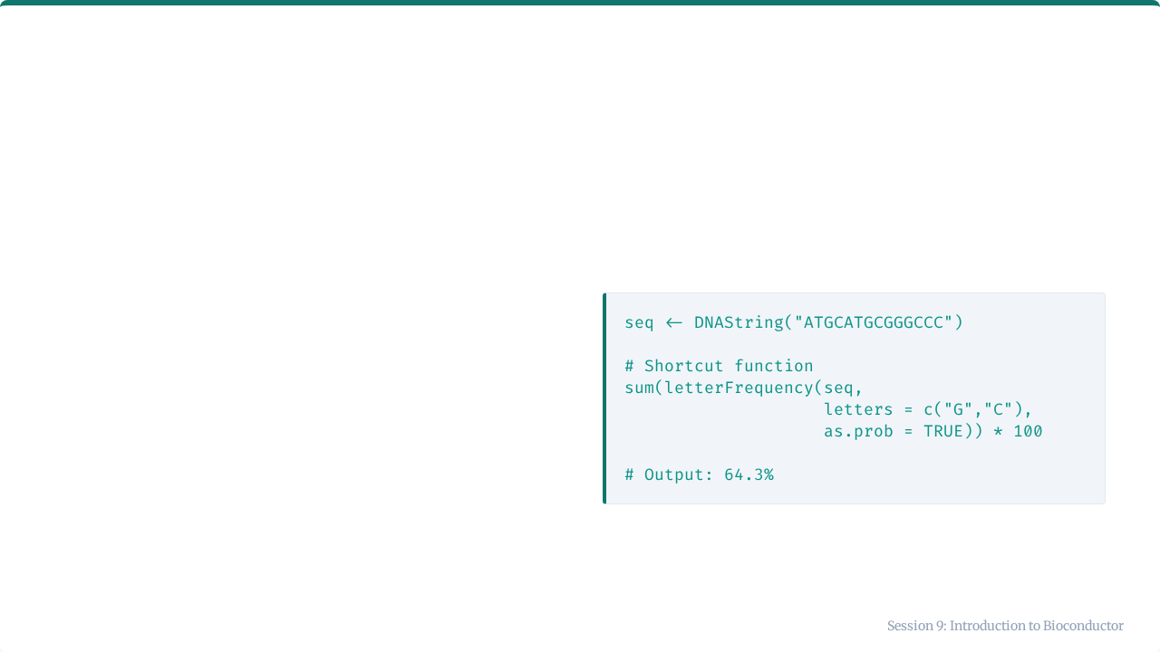
Calculating GC Content
Calculation
Why it matters
GC content affects melting temperature (Tm) and is a key metric in PCR primer design and genome characterization.

Slide 21
Biological Sequence File Formats
Format | Extension | Contains | R Function
FASTA | .fasta, .fa | Sequence only | readDNAStringSet()
FASTQ | .fastq, .fq | Sequence + Quality | readDNAStringSet(format="fastq")
AB1 | .ab1 | Sanger Chromatogram | sangeranalyseR package

Slide 22
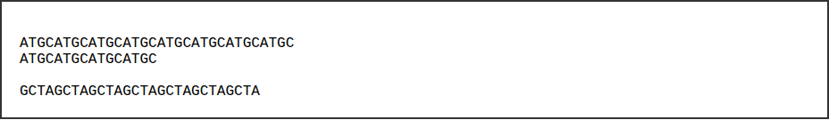
The FASTA Format
Simple, text-based format for representing nucleotide or peptide sequences.
>Sequence_Name_1
>Sequence_Name_2
•
Header line starts with >.
•
Sequence follows on next line(s).

Slide 23
Reading FASTA Files
# Read all sequences from FASTA file sequences <- readDNAStringSet("variants.fasta") # Access properties length(sequences) # Number of sequences names(sequences) # Headers (names) width(sequences) # Length of each sequence # Access specific sequence sequences[[1]] # First sequence

Slide 24
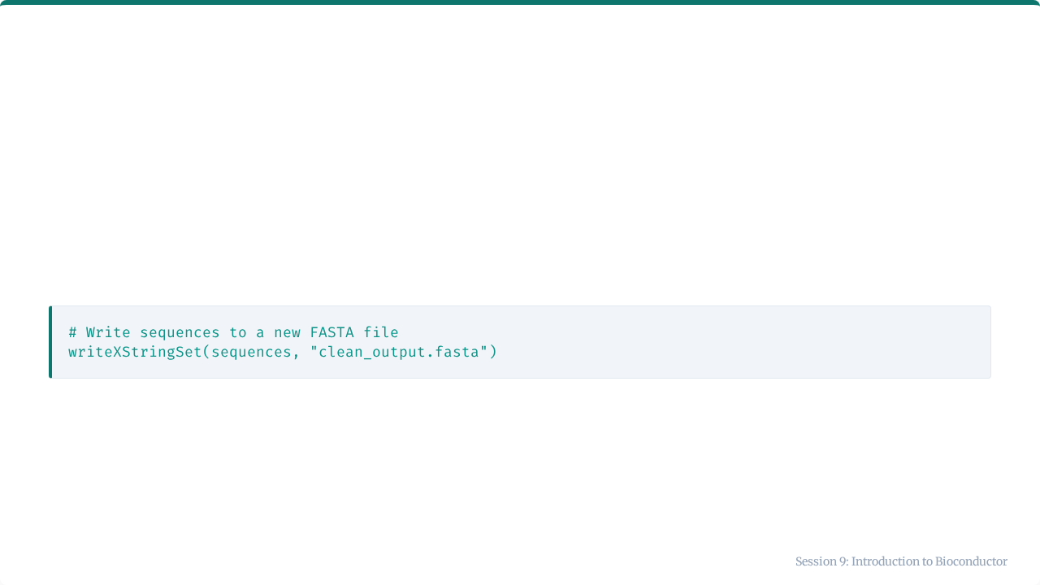
Writing FASTA Files
After processing data (e.g., trimming, filtering), you often need to save it.
This is useful for exporting data to other tools (like BLAST or alignment software).

Slide 25
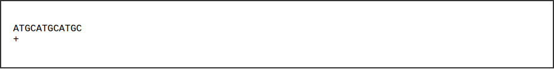
The FASTQ Format
FASTA + Quality Scores (used in NGS).
@Sequence_ID
IIIIIIIIIIII
•
Header starts with @.
•
+ separates sequence from quality.
•
Quality symbols represent probability of error (Phred score).

Slide 26
Reading FASTQ Files
# Standard read (ignores quality) fastq <- readDNAStringSet("reads.fastq", format = "fastq") # Reading with Quality (Requires ShortRead package) library(ShortRead) fq <- readFastq("reads.fastq") quality(fq) # Extract quality scores

Slide 27
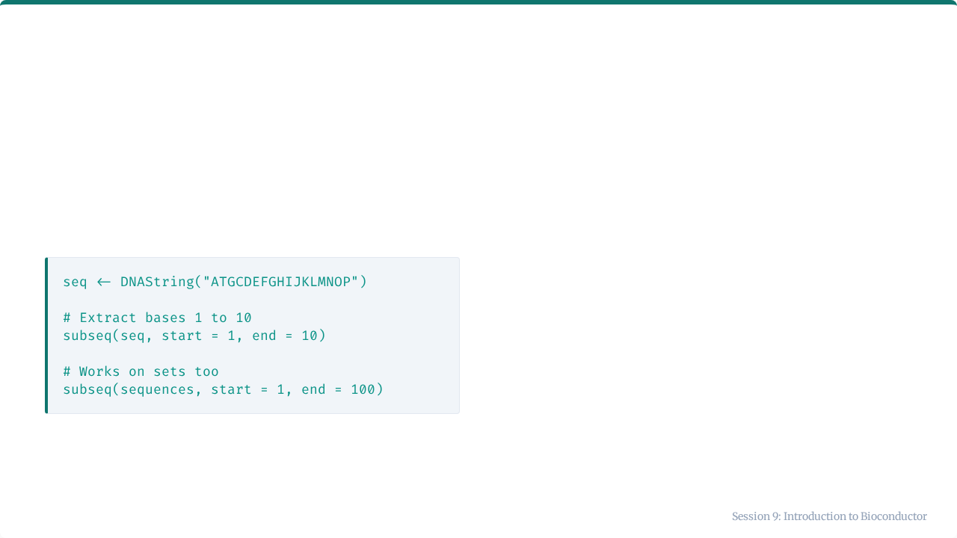
Extracting Subsequences
Extracting specific regions (e.g., a gene within a genome).

Slide 28
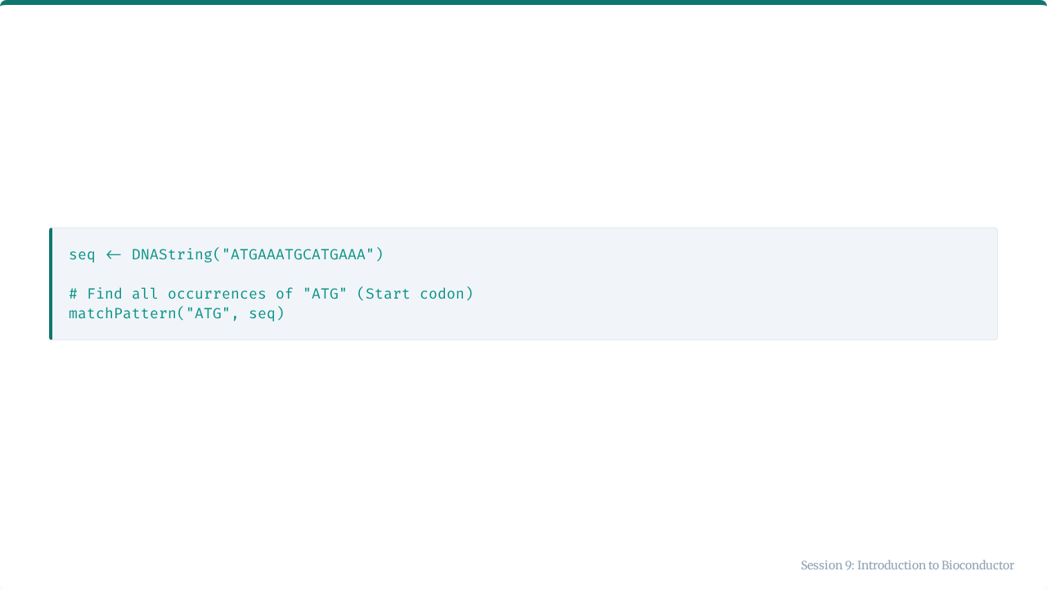
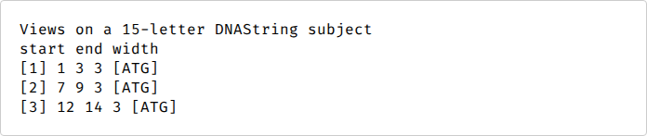
Finding Patterns (Motifs)

Slide 29
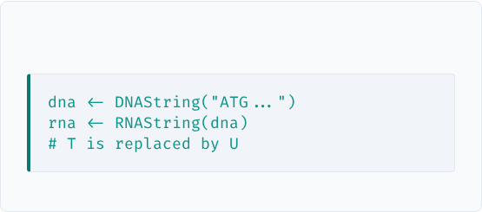
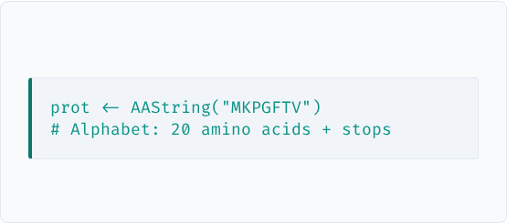
Other Molecular Types
RNAString
AAString (Protein)

Slide 30
Clinical Lab Applications
Application | Biostrings Use
Variant Detection | Align patient sequence vs reference to find mutations.
Genotyping | Locate SNPs in sequence data.
Species ID | Compare 16S rRNA sequences to databases.
Primer Design | Check GC content and melting temps.

Slide 31



Common Mistakes to Avoid
⚠️
↔️
🖼️
Alphabet
Direction
Frame
Using DNA functions on RNA objects (or vice versa).
Forgetting to Reverse Complement when analyzing the opposite strand.
Translating without checking the Open Reading Frame (ORF).

Slide 32
Key Takeaways
Bioconductor is the hub for R bioinformatics.
Use BiocManager to install packages.
DNAString/Set classes handle sequences efficiently.
Essential functions: readDNAStringSet, translate, reverseComplement.
FASTA is the standard format for sequences.

Slide 33

Tutorial 9
Sequence Manipulation in Practice
Open your R environment

Slide 34
Tutorial 9: Sequence Manipulation
Working with SARS-CoV-2 Variant Sequences

Slide 35
Your Scenario
The Task
You are analyzing SARS-CoV-2 variants.
You have sequences for:
•
Wuhan-Hu-1 (Reference)
•
Alpha (B.1.1.7)
•
Delta (B.1.617.2)
•
Omicron (BA.1)

Slide 36
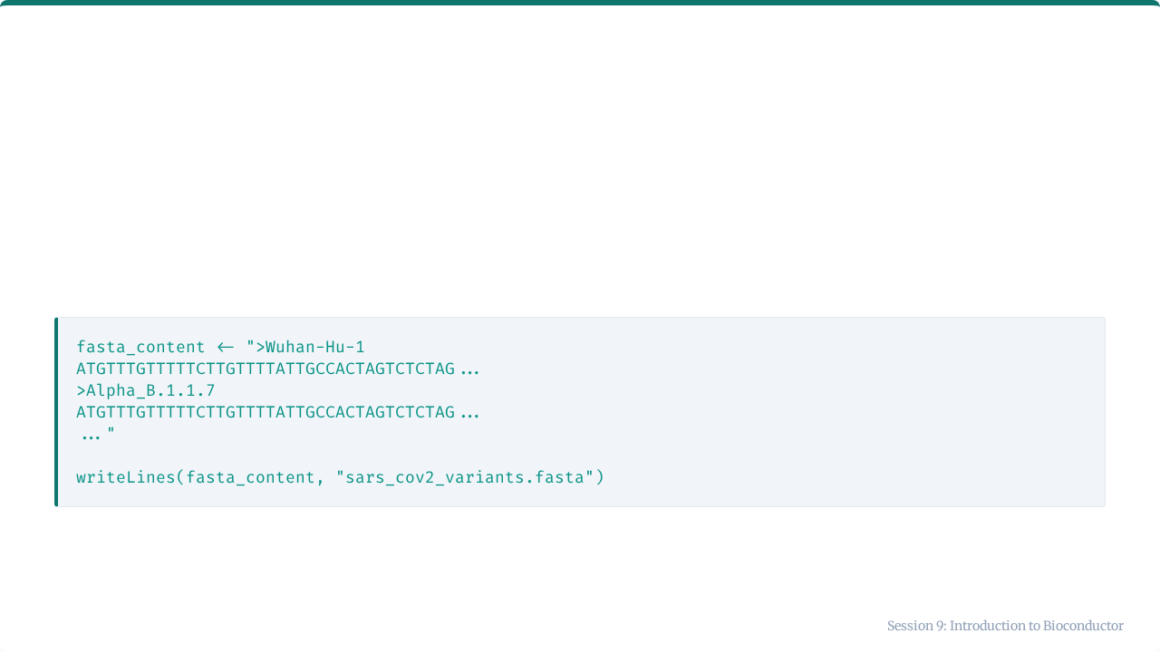
Step 1: Create FASTA Data
We will generate a FASTA file containing simplified Spike gene sequences.

Slide 37
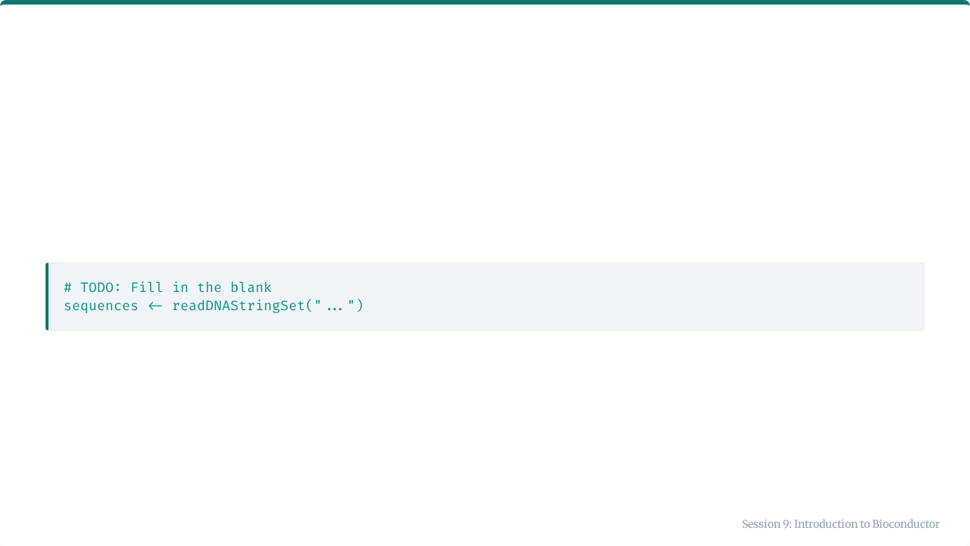

Step 2: Read the FASTA File
Use the Biostrings function to load the data.
Check: You should have an object of length 4.

Slide 38
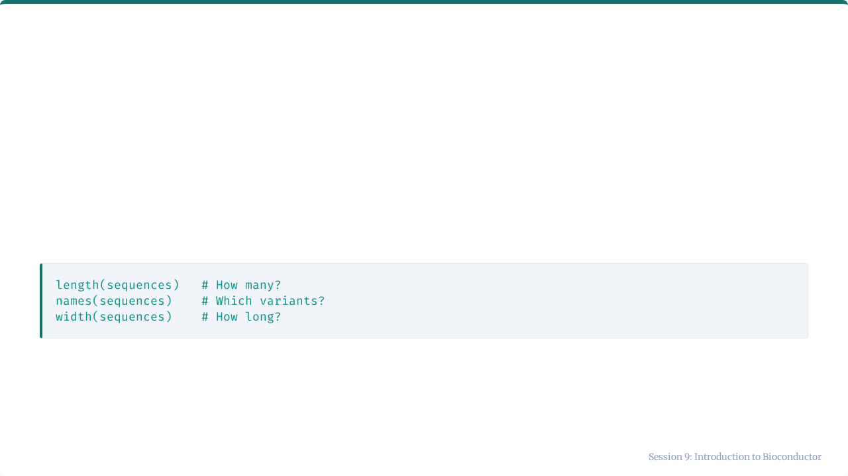
Step 3: Explore Properties
Inspect your data object.

Slide 39
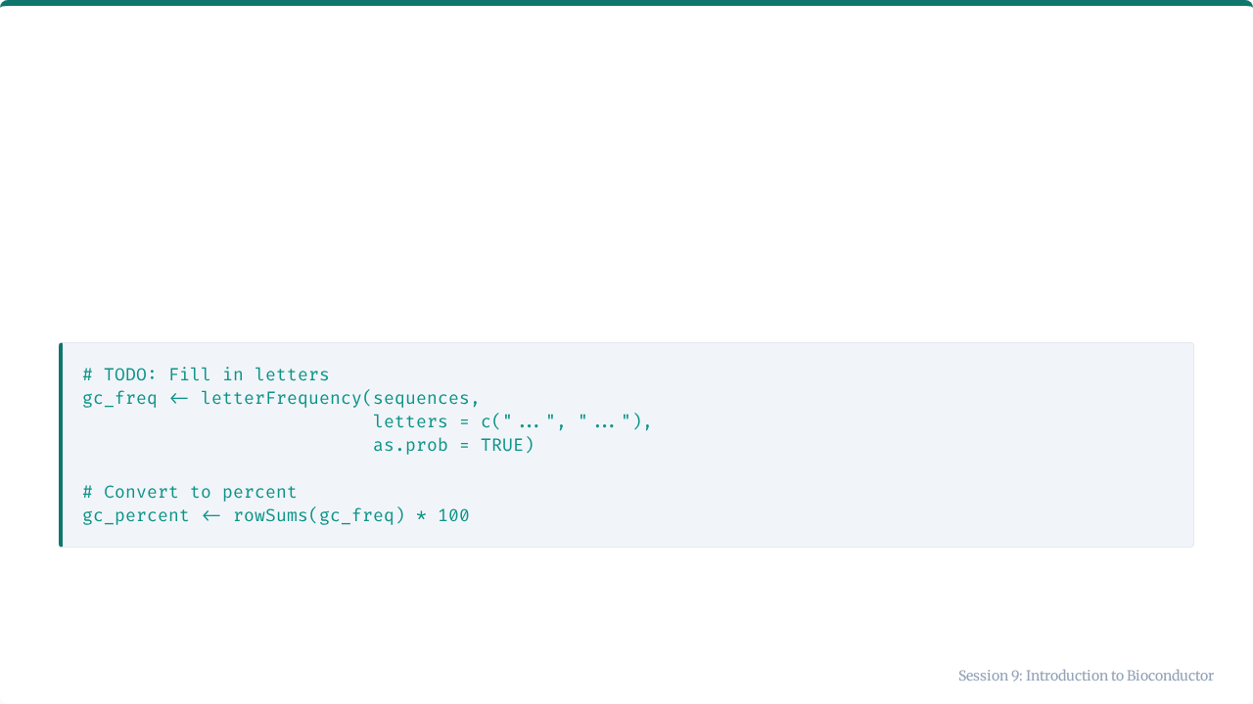
Step 4: Calculate GC Content
Calculate the percentage of G and C nucleotides.

Slide 40
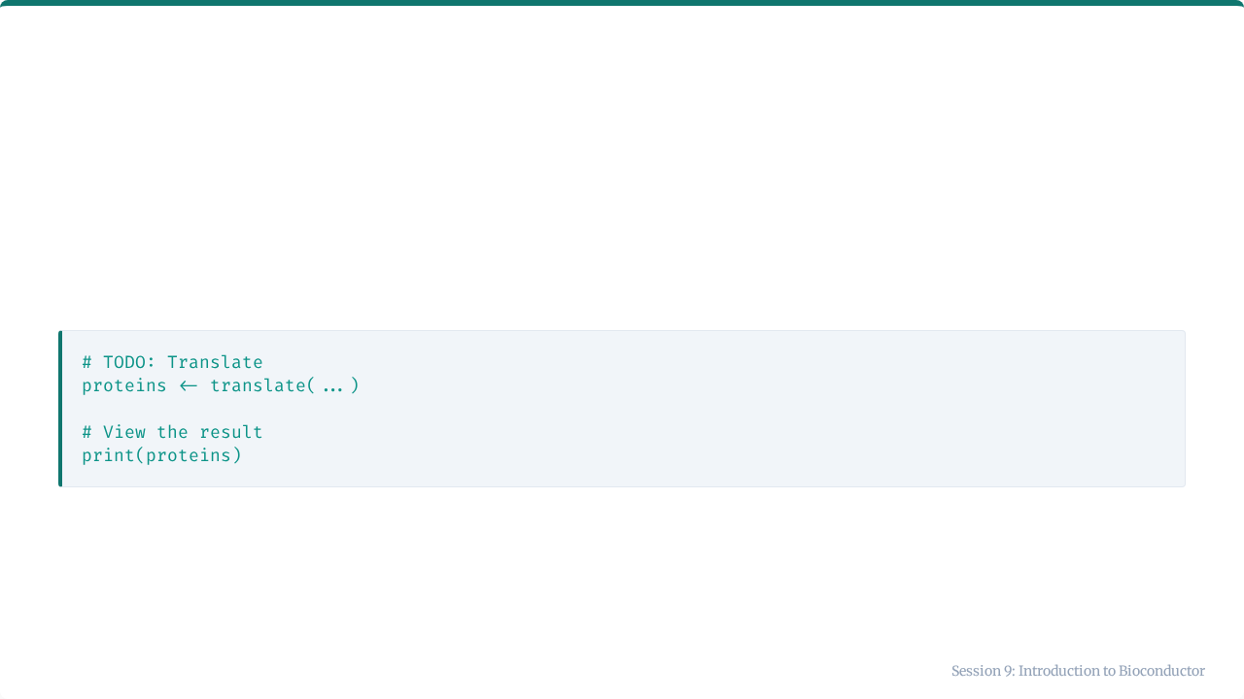
Step 5: Translate to Protein
Convert the DNA sequences to Amino Acid sequences.
This allows us to see if mutations (DNA changes) result in amino acid changes.

Slide 41
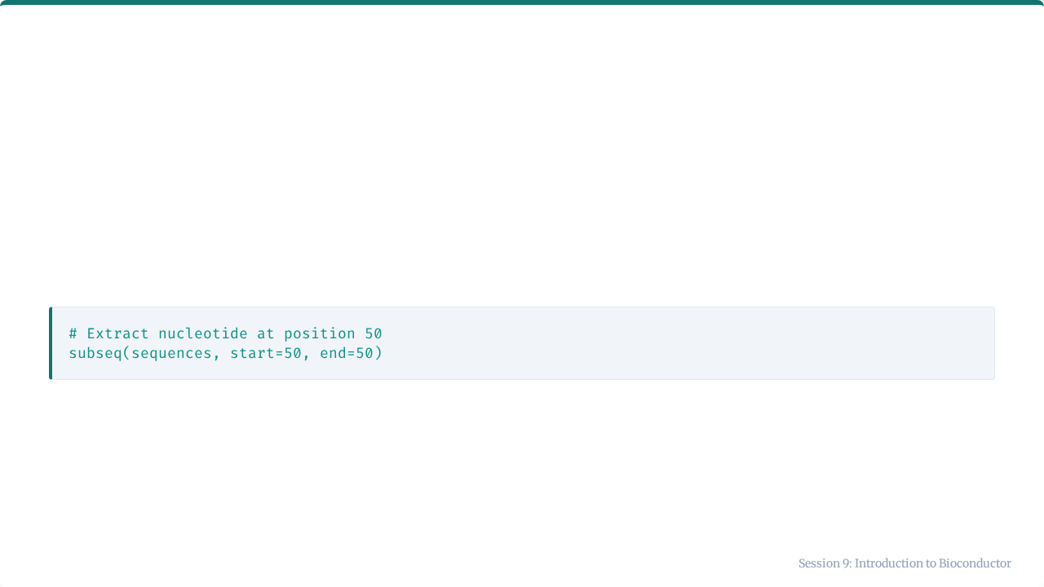
Step 6: Compare Positions
Extract a specific nucleotide to see differences.
Does the Omicron variant differ from the Wuhan reference at this position?

Slide 42

Session 9 Complete
You have successfully entered the world of Bioconductor!

